Slide 11
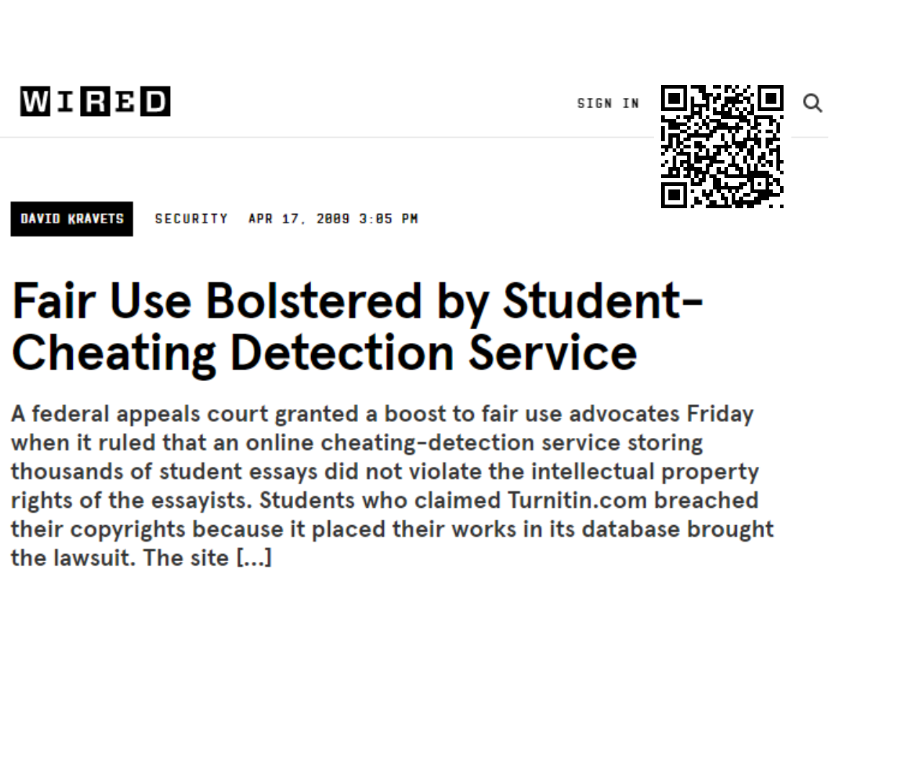

Slide 14
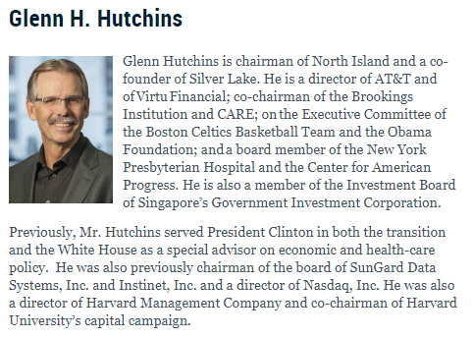
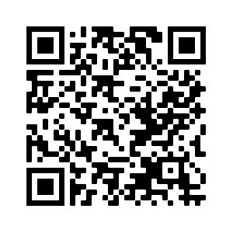
Bancorp
Brevan Howard Asset Management
Deutsche Bank AG
Emerging Markets Management, LLC
Goldman Sachs
KeyCorp
Legato Capital Management LLC
Lewis Corporate Advisors, LLC
RRE Ventures
T. Rowe Price
TD Bank Group
Wenzi Capital Partners

